Slide 1
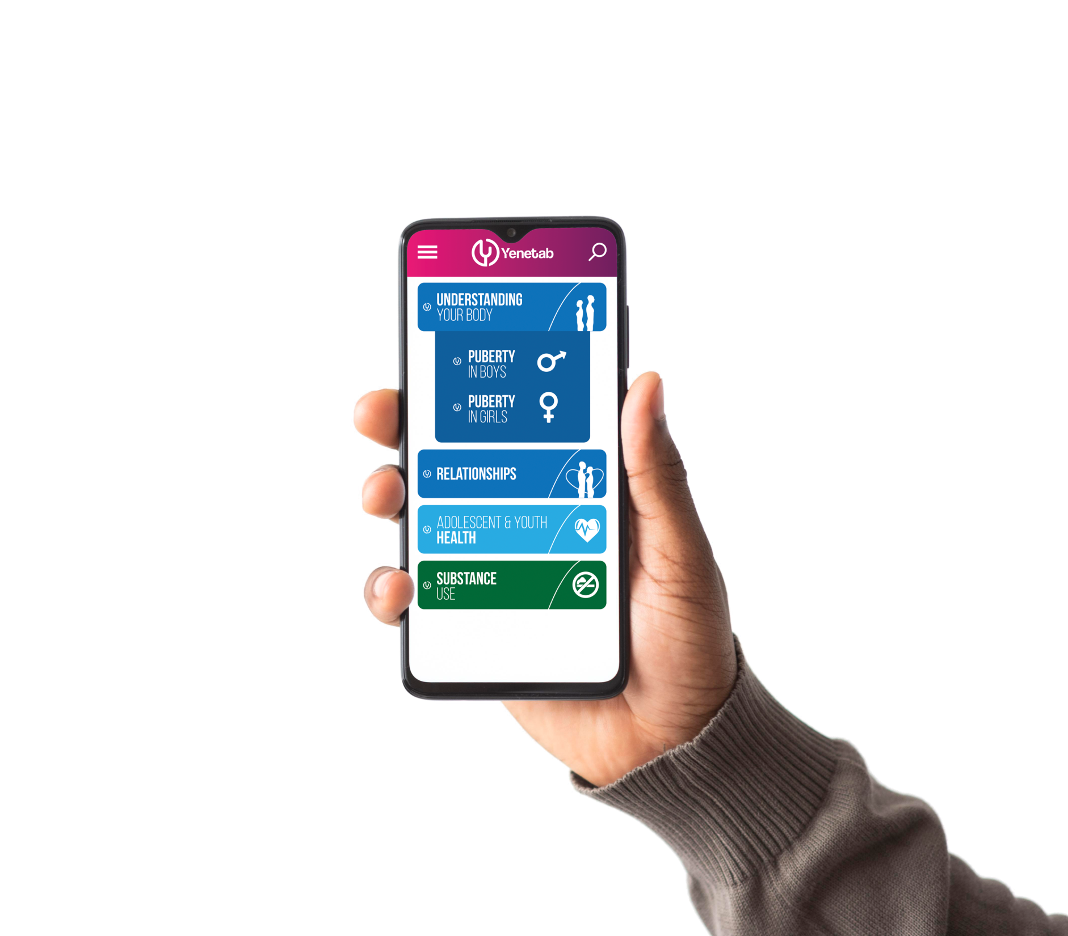


Mobile application
By: Betelhem B.
December 2, 2021

Slide 2
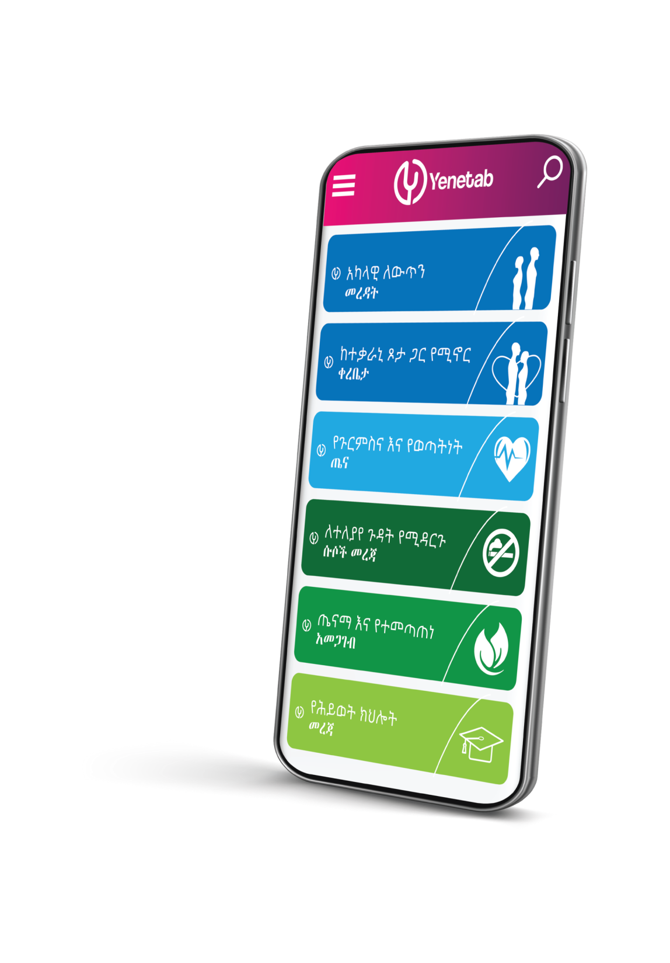
OUTLINE
Introduction
Objective
Process of app development
Approaches
Components
Testing
What will be next?

Slide 3
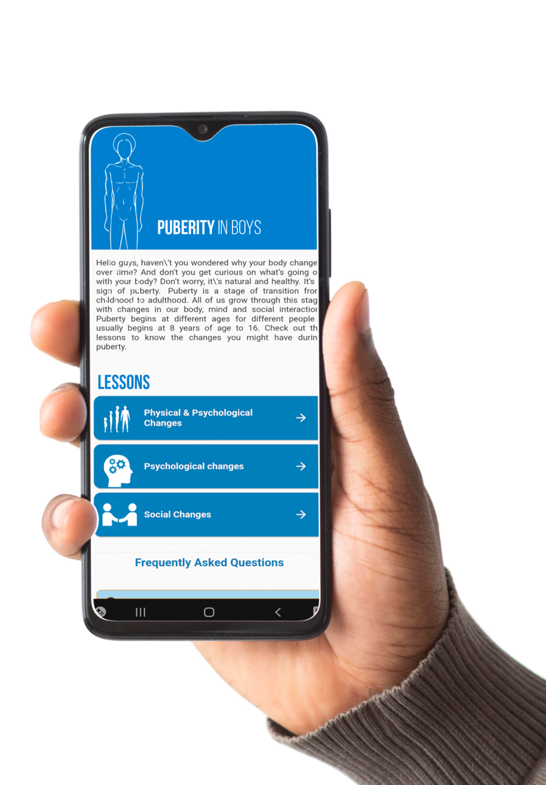
INTRODUCTION
Technologies are changing the way in which communication and development are occurring in the world.
Especially adolescents and youth have more attachment to mobile devices to get any kind of information due to rapid changes in the brain/body to explore new learning's.
As part of BCC strategy; using technology to reach young people is being used around the globe.

Slide 4
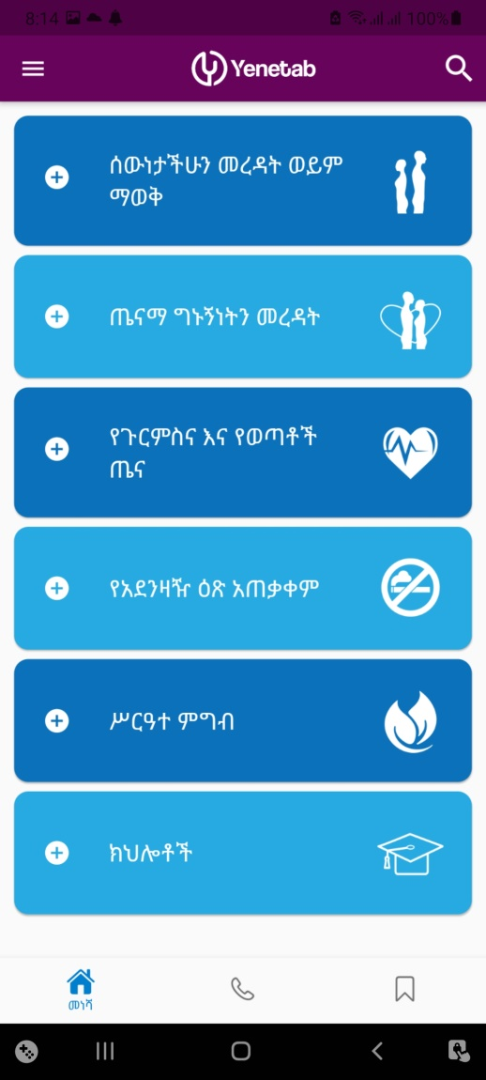
Sexual and reproductive health information is preferred to be channeled for them confidentially due to social and structural barriers exist here and there.
Developing a mobile application to disseminate health and other related information planned to reach them.
Intended to improve their knowledge of health and life skills in an engaging manner.

Slide 5
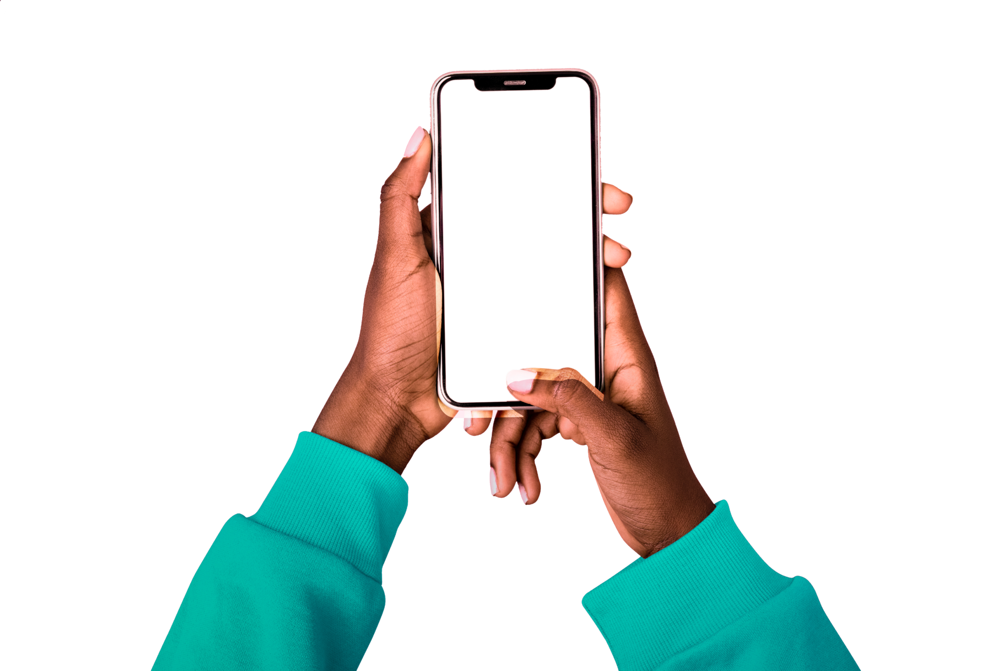

OBJECTIVE
Increase access to comprehensive and reliable information on AYH and basic skill for adolescent and youth through their mobile phone to make informed decision.

Slide 6
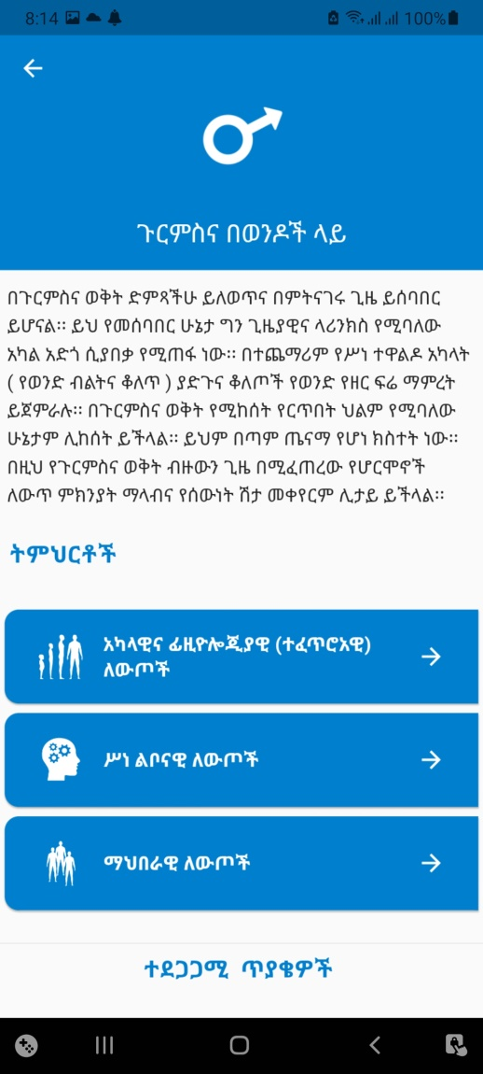
APP DEVELOPMENT PROCESS
Following the evidences on use of current mobile technology and preference to get information; terms of reference prepared.
To guide the development of application
Inform roles and responsibilities of all stakeholders
Small TWG formed to facilitate the app development who had experience in digital health system and volunteer to engage in the process from larger working group.

Slide 7
APPROACHES
Establish small working group
Brainstorming sessions
First consultation
Content drafting
Design drafting
Testing of draft app with youth and expert
Develop the final version of mobile application

Slide 8
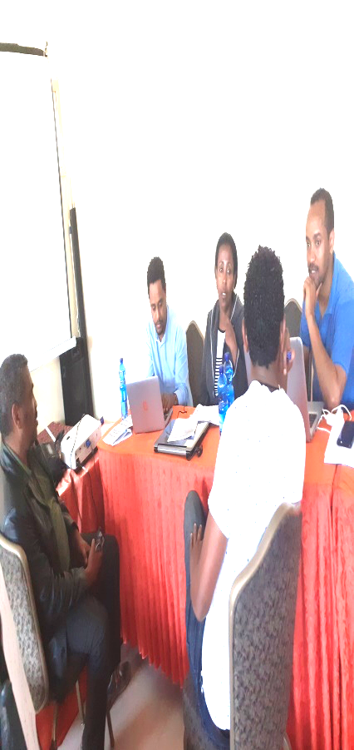
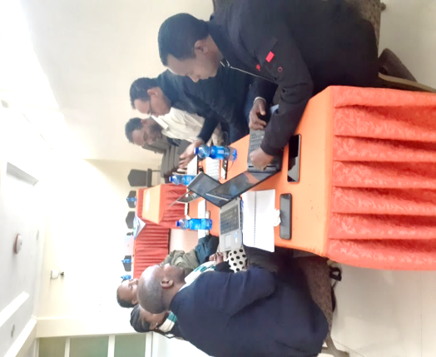
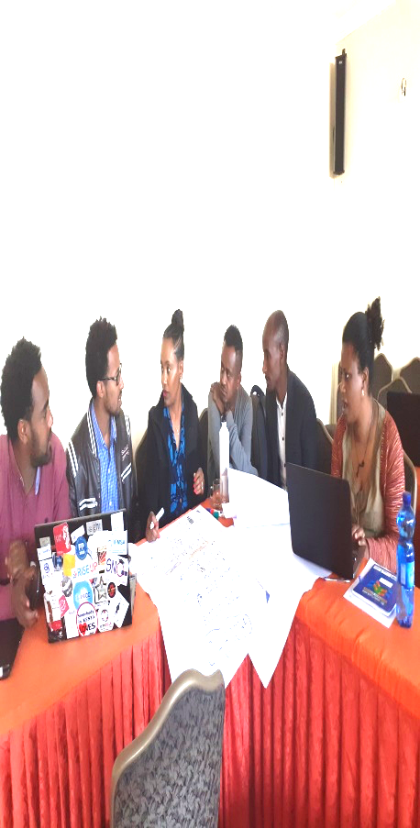

Slide 9
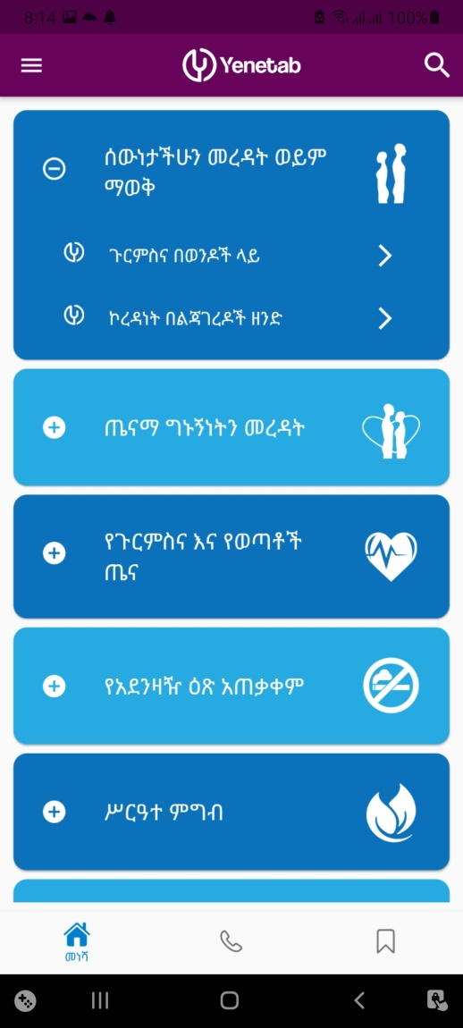
COMPONENTS
Yenetab is composed of six main topics on its home page:
Understanding your body,
Relationships,
Sexual and Reproductive Health,
Substance use,
Nutrition and
Skills.

Slide 10

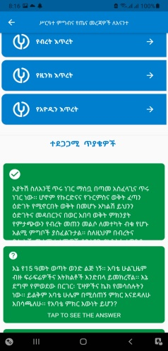
COMPONENTS
Additional
Frequently asked questions with expert responses
Help center
Library
Jobs and opportunity
About
Settings

Slide 11
TESTING
Youth group
Program Experts
Language Experts

Slide 12
YOUTH FEEDBACK
“ I want to suggest that if possible to create two version, one online and other offline and I really like the app its very user friendly and informative.” said Hana
“ I liked that it has websites where free e-books can easily be downloaded.” said Bethel
“ It will be better of you add question and answer part for transmission and prevention method.” said Yeab
“ It will be more likely to let user of the app have access to login and ask questions to the group/ channel for specific users like peer discussions digitally” said Joy

Slide 13
EXPERT FEEDBACK
FAQ need revision due to misplacement of topics and messages, also need revision.
Adolescent nutrition missed and it is better to add
Add emergency contraception on FAQ section that discourage regular use and side effect of long term use
Myth on Khat missed

Slide 14
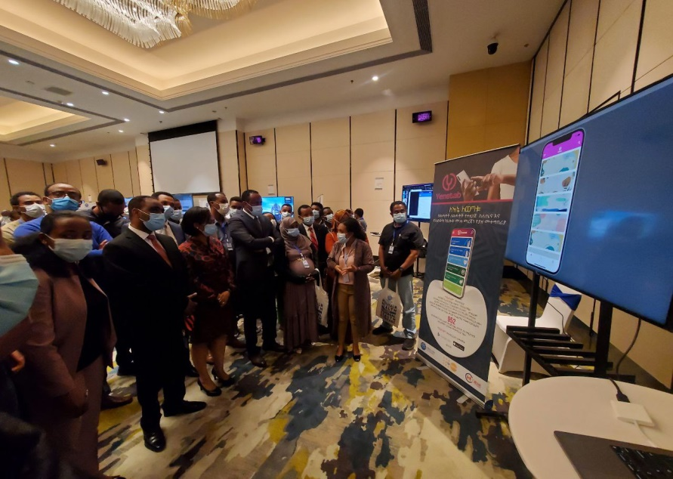

CURRENT STATUS
The final version of yenetab is released as of August 2021.
It is available in six languages
English, Amharic, Oromiffa, Tigrigna, Somaligna, and Afarigna
An average of 35 to 55 users open the app on daily basis.
Dissemination and advocacy works are on progress

Slide 15
UPDATE
Working on update to make inclusive for person with visually impairment.
Instruction prepared
Beta version launch
Feedback collected from users and incorporated.

Slide 16
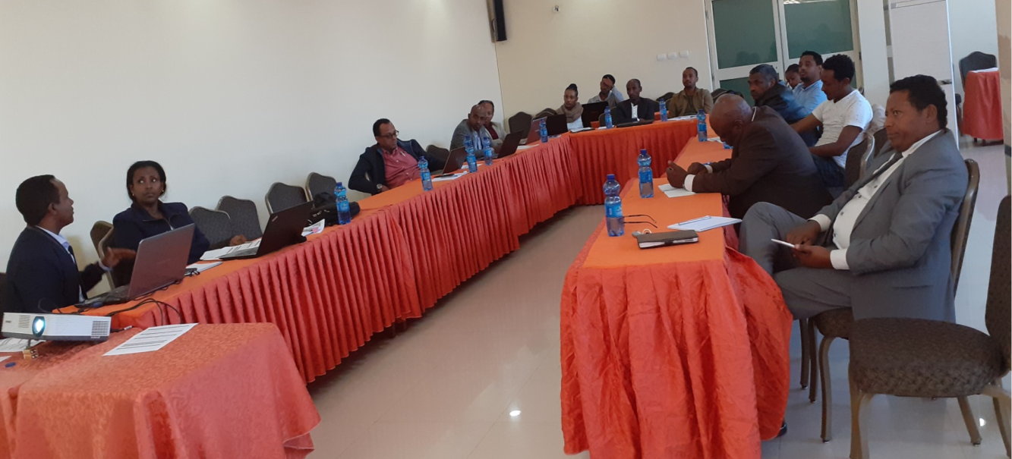
ACKNOWLEDGEMENT
Youths participated in process
Maternal, Child and Adolescent Health Experts and leaders of MOH
Language experts
App developers
UNFPA

